Slide 1
Center for Diversity in Public Health Leadership Training

Slide 2
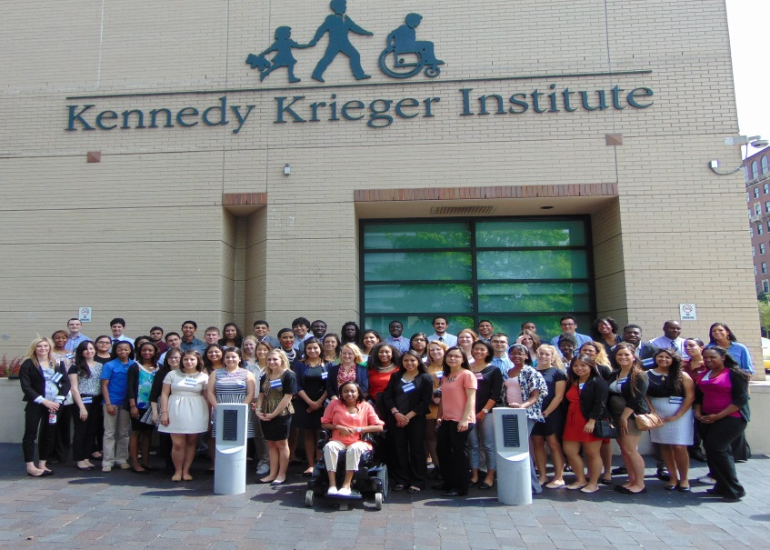
Center for Diversity in Public Health Leadership Training at Kennedy Krieger Institute (formerly the Research Initiatives for Student Enhancement Programs-RISE)
Center for Diversity in Public Health Leadership Training
The mission of the Center is to reduce socially determined childhood brain disorders through leadership development of diverse scholars who use culturally relevant, and evidence-based, approaches to inform research, practice, advocacy, and policy.

Slide 3
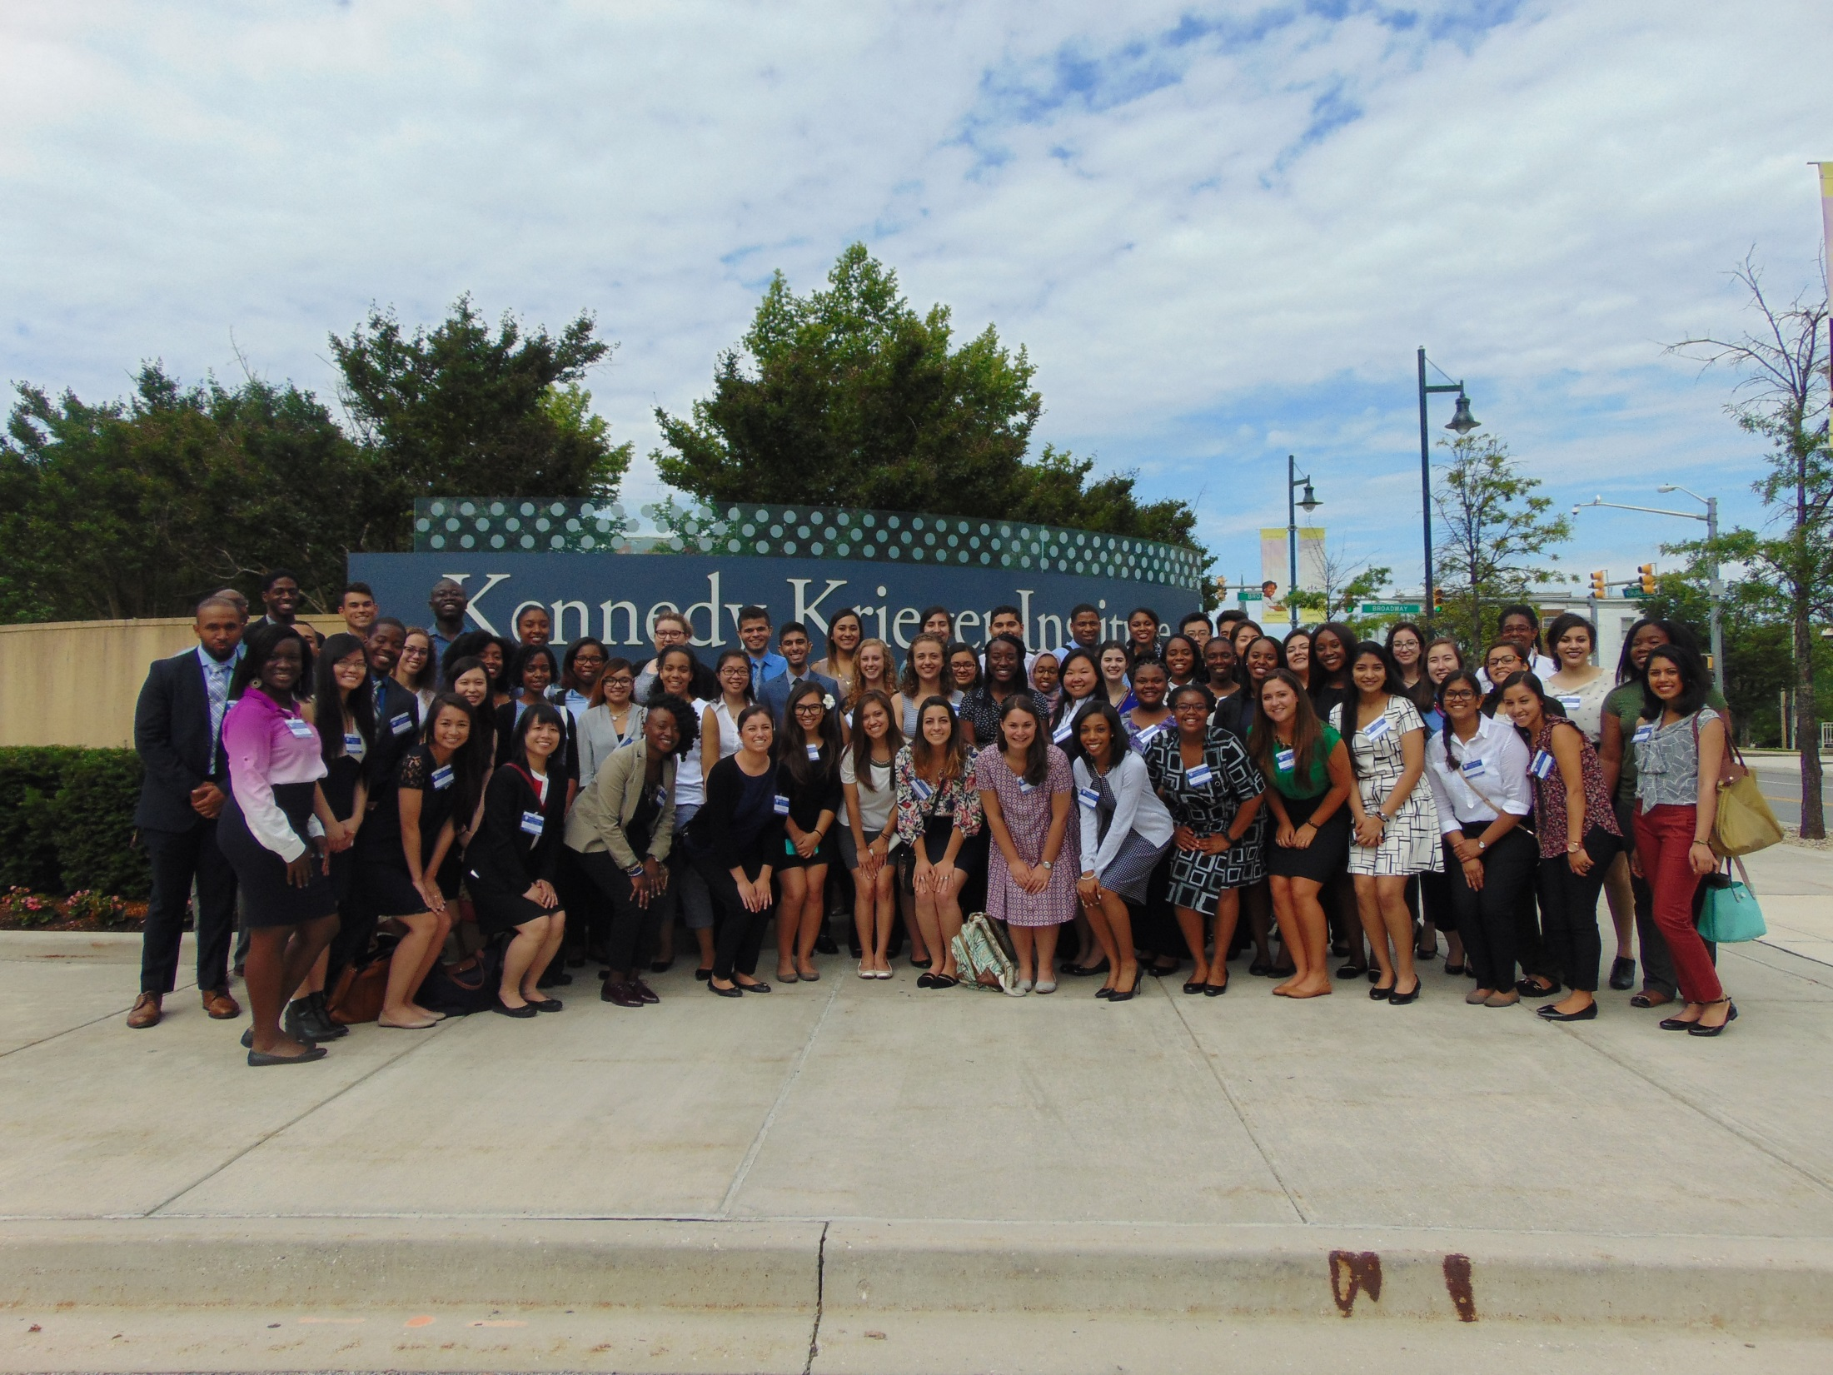

Slide 4
Center for Diversity Programs
Educational opportunities funded by the Centers for Disease Control and Prevention, Office of Minority Health and Health Equity (CDC), & Health Resources Services Administration (HRSA)
MCHC-RISE-UP
DR. JAMES A. FERGUSON EMERGING INFECTIOUS DISEASES RISE FELLOWSHIP
MCH-LEARN

Slide 5
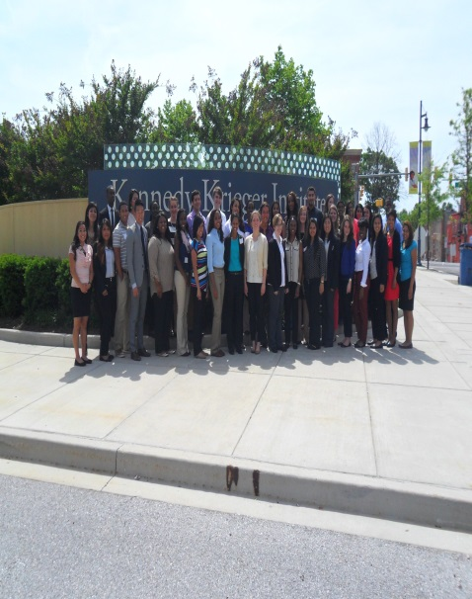
Educational Topics and Priorities
Public health experiences targeting public health challenges & health disparities
Disabilities
CDC Winnable Battles
Social Determinants of Health
Infectious Diseases
Maternal Child Health Issues
LGBTQI Health
Men’s Health
Mental Health
Health Policy

Slide 6
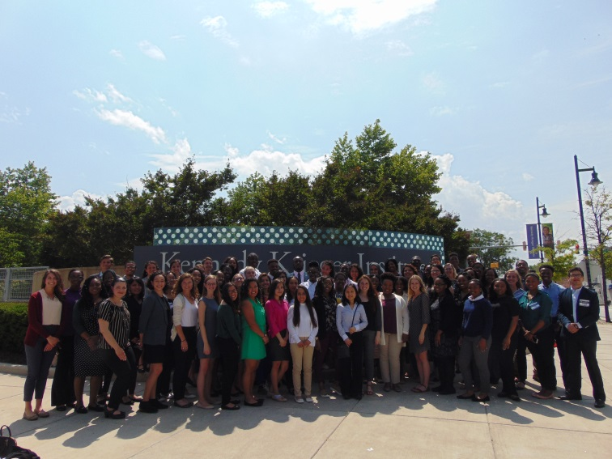
What we do!
Recruit students annually from diverse populations to participate in activities to address ongoing and emerging health challenges and areas of health disparities.
Provide a didactic interdisciplinary core curriculum and externships that incorporate public health competencies to prepare scholars to be leaders in the Public Health field.

Slide 7
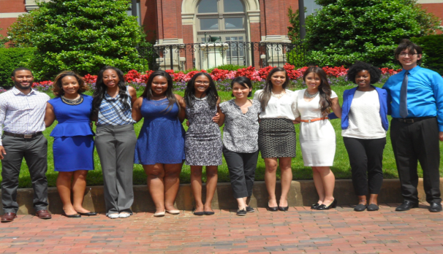
What we do!
Disseminate information that connects scholars and other professionals to evidence-based practices and new knowledge in the fields of public health
Increase scholars from underrepresented populations who select maternal and child health and public health careers.

Slide 8
Applications Go Live November 1st
www.KennedyKrieger.org/CenterforDiversity

Slide 9
Dr. James A. Ferguson RISE 2019 Fellowship
Harolyn M.E. Belcher, MD, MHS
Professor of Pediatrics
Johns Hopkins U School of Medicine
Director, Center for Diversity in Public Health Leadership
Kennedy Krieger Institute

Slide 10
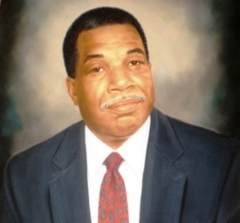
James A. Ferguson, DVM, PhD (1938-1998)
Instituted in 1989 at the CDC/NCID as an ten-week Summer Research Fellowship Program.
Originally designed for scholars from racial and ethnic populations underrepresented in the medical and veterinary scholars to explore the broad range of public health career opportunities. Served on NCID’s Board of Scientific Counselors.
First partners: Morehouse School of Medicine and Tuskegee University School of Veterinary Medicine
Fourth dean of Tuskegee University’s School of Veterinary Medicine and first Tuskegee alumnus to serve in that capacity in 1991.The program was renamed in his honor in 1999.
Notes:
Dr. James A. Ferguson was the fourth dean of Tuskegee University’s School of Veterinary Medicine, and the first Tuskegee alumnus to serve in that capacity. During his tenure at Tuskegee, Dr. Ferguson was instrumental in encouraging the summer fellowship program at CDC, where he served as a member of NCID’s Board of Scientific Counselors.
In recognition of his contributions to the mission of CDC and his commitment to helping minority students pursue careers in public health, the fellowship program was renamed in his honor in 1999 after his death.
Beginning in 2000 the program was expanded to include not only Historically Black Colleges and Universities, medical and veterinary schools, but also schools of public health, dentistry and pharmacy.

Slide 11
Ferguson RISE Fellowship Goals
Promote knowledge of and commitment to careers in public health.
Engage graduate students who are under-represented in medical, dental, veterinary medicine, pharmacy, social sciences, and public health professions.
Provide research (CDC & Kennedy Krieger) and clinical experiences (Kennedy Krieger) to develop critical thinking, leadership skills, and scientific presentations (conferences and peer-reviewed papers).
Mentor and introduce students to other public health fellowships and career opportunities at CDC.
Notes:
The ultimate goal of the program is to grow the representation of well qualified under-represented minorities in the public health professions.
However, all graduate students, regardless of race or ethnicity, are eligible to apply.

Slide 12
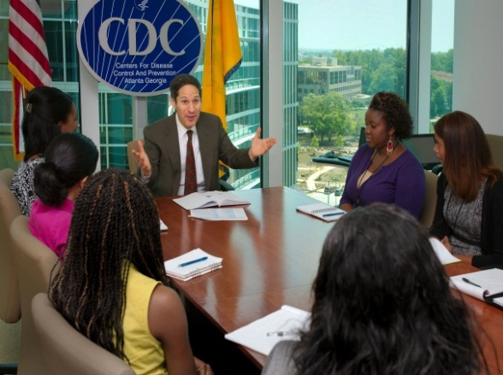
Public Health Research and Career Exploration
Core public health knowledge focusing on health disparities & social determinants of health
Infectious Diseases and health disparities research experiences
Research Accountability Groups (RAGS)-Wednesdays 7:30 AM-11AM
Weekly public health research leaders
Professional and research development
through mentoring
Abstract writing
Presentation experience
Publications
Leadership experience (e.g., near-peer mentoring)
Networking/Employment opportunities
Notes:
The Ferguson Fellowship is a 9 week public health training program that includes a one-week orientation in public health policy and practice, and 8 weeks of mentored infectious diseases research and career exploration.

Slide 13
Summer Programs
All Scholars
Baltimore Orientation: Monday, May 25-28, 2020
Ferguson RISE CDC Orientation extends to May 29, 2020
9-10 weeks: June 1- July 29, 2020

Slide 14
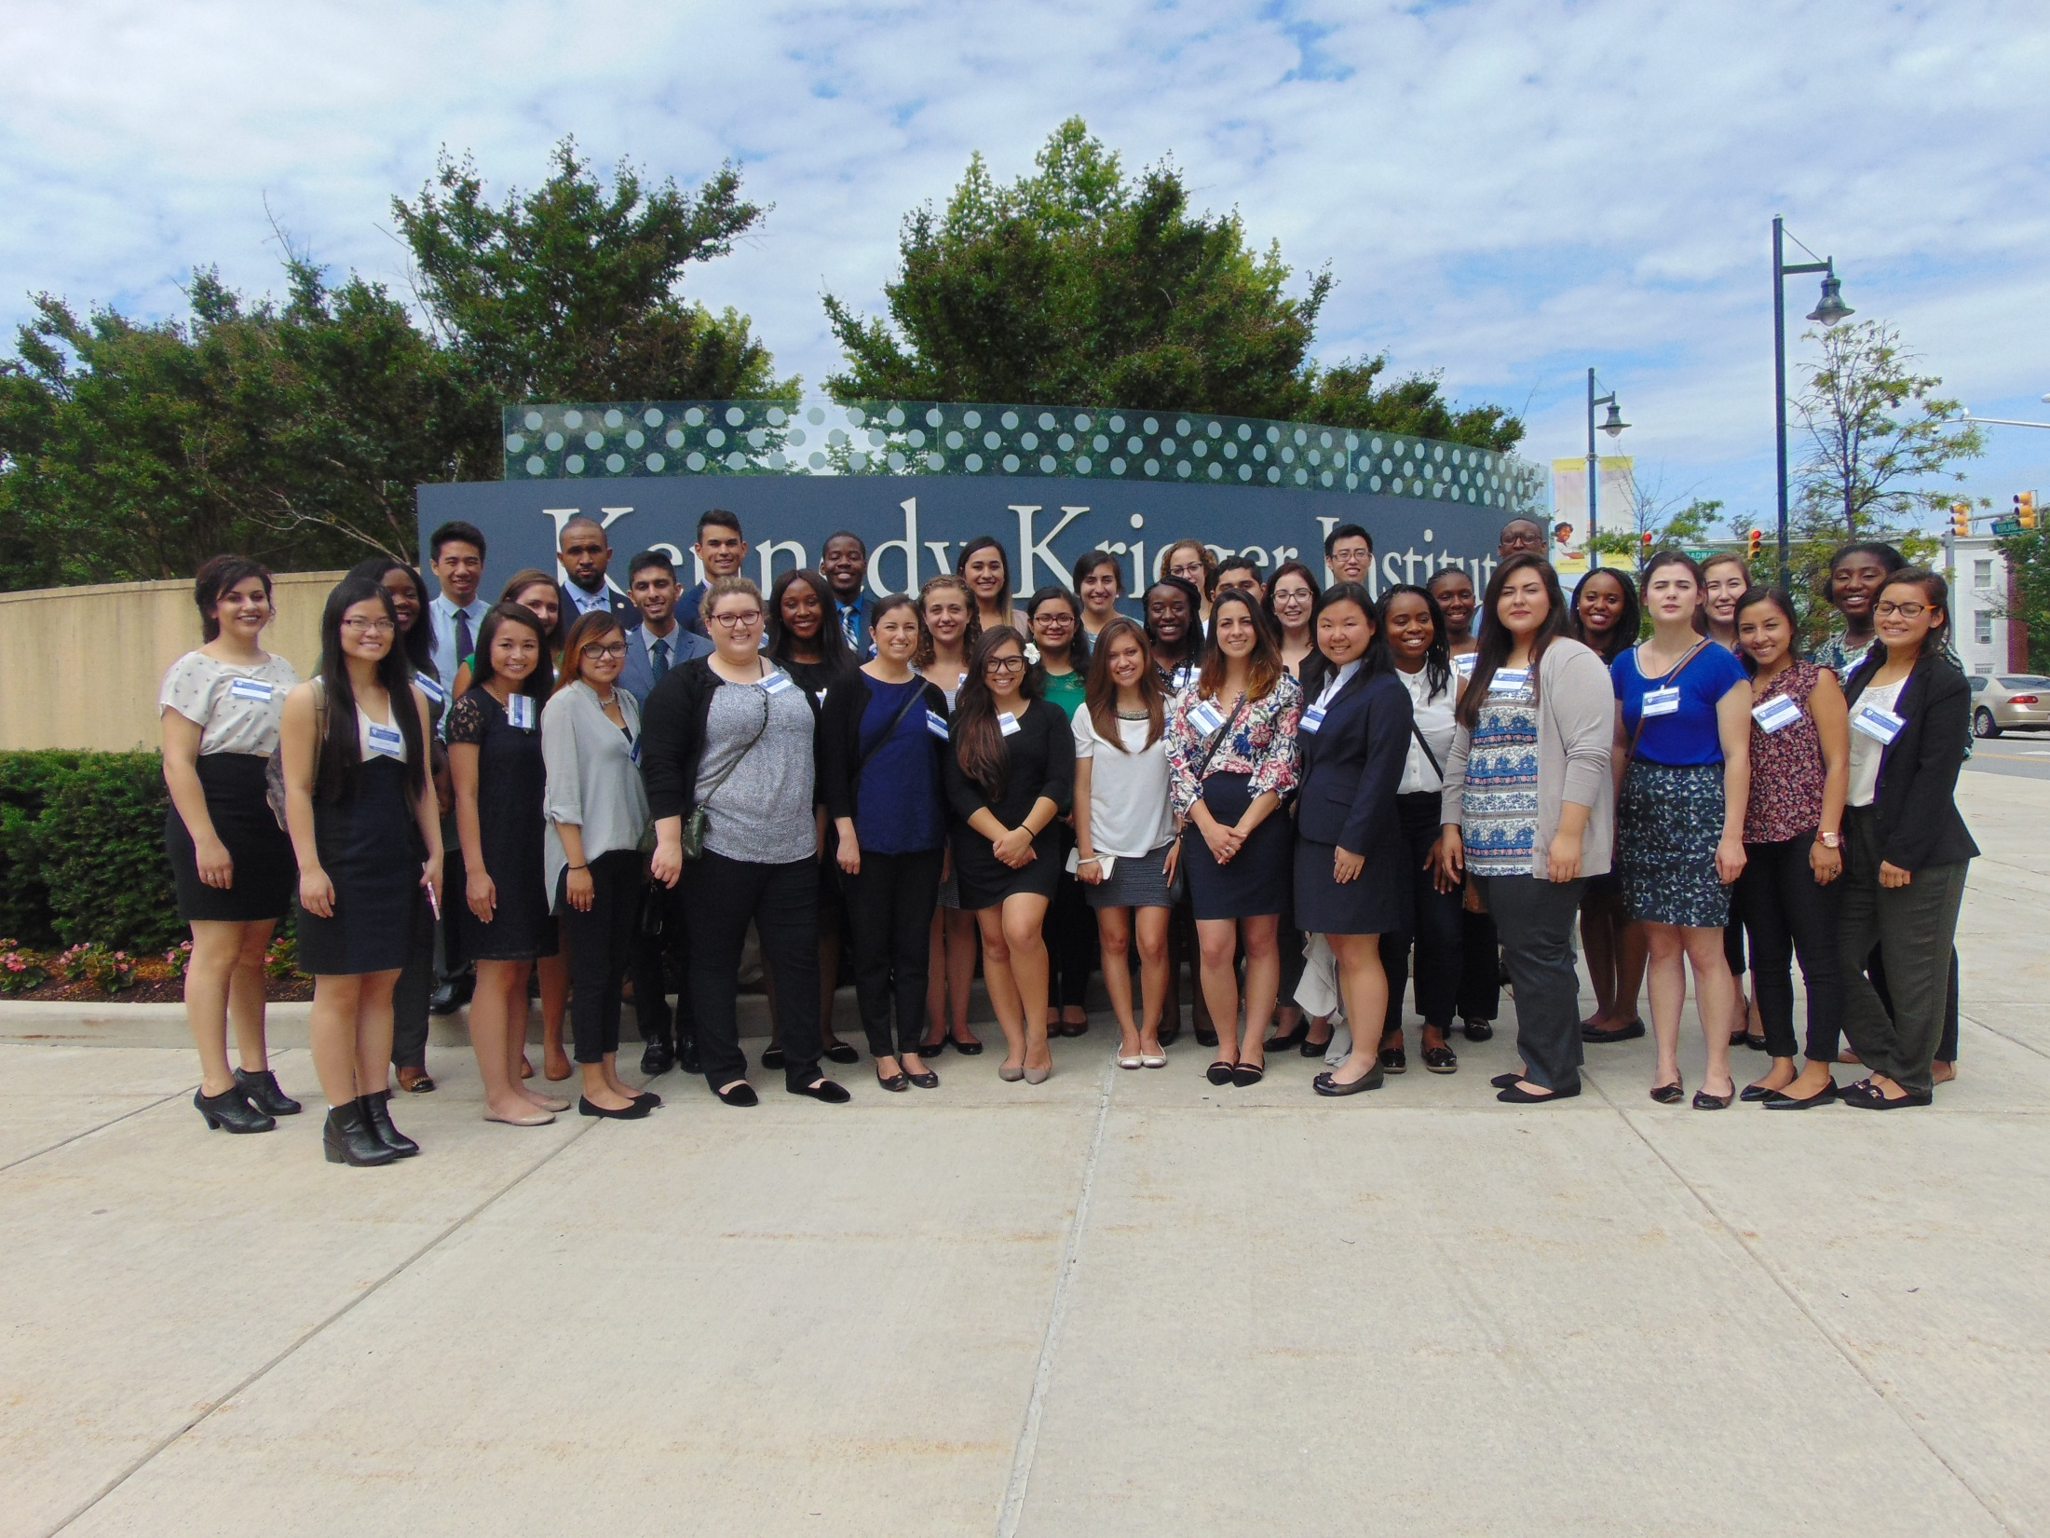
Maternal and Child Health Careers/Research Initiatives for Student Enhancement
(MCHC/RISE-UP)

Slide 15
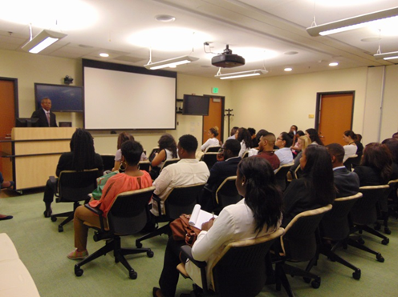
Center for Diversity
MCHC/RISE-UP 2012-2022
Centers for Disease Control and Prevention
Undergraduate juniors and seniors, and baccalaureate degree scholars
MCHC/RISE-UP Public Health Leadership Experiences:
Clinical
Community Engagement & Advocacy
Research
3 sites:
KKI-Baltimore
University of South Dakota
University of California-Davis

Slide 16
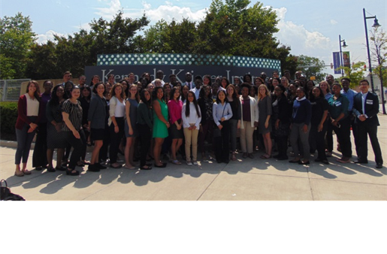
MCHC/RISE-UP
National Consortium of AUCD Institutions
Kennedy Krieger Institute/Johns Hopkins Medical Institutions
Historically Black Colleges and Universities
University of South Dakota
Tribal Serving Institutions
University of California-Davis
Office of Equity, Diversity, and Inclusion

Slide 17
Enhancing Mentoring
Mentor Readiness

Slide 18
Enhancing Mentoring Model
Promote Equity, Diversity, and Inclusion
Ensure Mutual Understanding and Expectations
Develop Academic & Research Goals
Facilitate Professional Development and Self-Advocacy
Support Independence, Self-Efficacy, and Leadership
COMMUNICATION
Foster Trust
Finding Common Interests & Professional Synergy

Slide 19
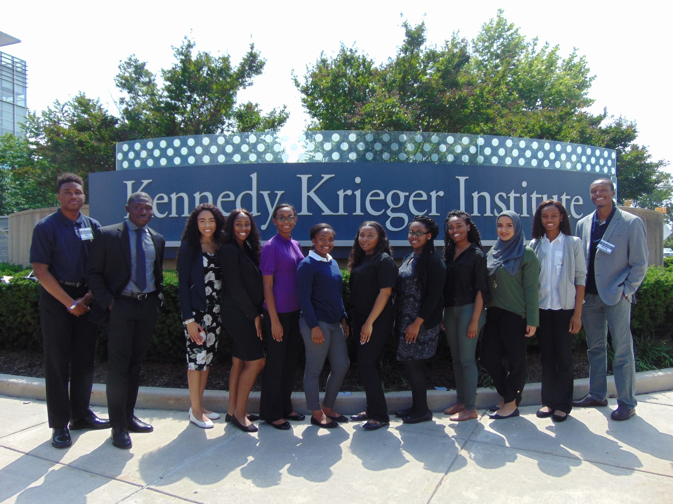
MCHC/RISE-UP: Program Activities
Scholars can select up to two experiences:
Clinical
Community Engagement and Advocacy
Research
Mentorship
Program Learning Didactic Day
CDC Winnable Battles
Public Health Leadership
Maternal and Child Health Leadership Education Advocacy Research Network MCH-LEARN

Slide 20
MCH-LEARN
Baltimore-Washington, DC Undergraduate Freshman and Sophomore
Interested in MCH professions (pediatric medicine, nutrition, social work, nursing, pediatric dentistry, psychology, health education, pediatric occupational / physical therapy, speech language pathology, public health)
Grade Point Average: 3.0 on a 4.0
scale

Slide 21
MCH-LEARN: Program Activities
Research + Clinical/Community
Program Learning Seminars
Health Disparities across the Life Course
Professional Development and Advocacy
CDC Winnable Battles
Public Health Leaders
Family as Faculty Program
Sponsored national conference presentation

Slide 22
Center for Diversity Annual Conference
Room to Grow: Journey to Cultural and Linguistic Competency
National speakers present on the latest research and practice addressing and reducing socially determined health disparities
September 22, 2020- Johns Hopkins Hospital

Slide 23
What success looks like

Slide 24
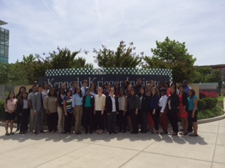
Questions?
Center for Diversity in Public Health Leadership Training
Director: Harolyn M.E. Belcher, M.D., M.H.S.
Manager: Jenese McFadden, DM
Kennedy Krieger Institute
www.kennedykrieger.org/centerfordiversity
Thank you!

