Slide 1
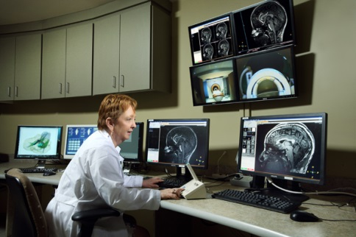


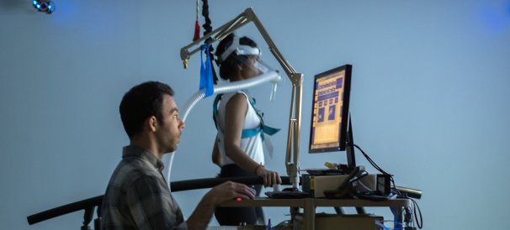
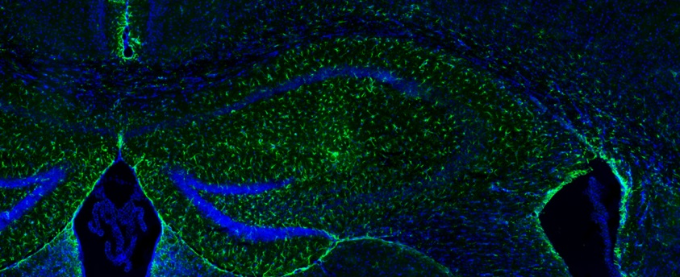
Intellectual and Developmental Disabilities Research Center (IDDRC)
Provides research services to faculty engaged in research related to the field of IDD at little or no cost
Funded by NICHD
IDDRC services include:
  Consultation and protocol development
  Registries and recruitment
  Access to lab and imaging facilities
  Testing facilities
  Statistical analyses
  And more!
  For more info or to request IDDRC services: www.KennedyKrieger.org/IDDRC
Notes:
OVF movements are thought to be charactersitic of deficiant motor inhibition, motor control and developmental motor immaturity

